Slide 1
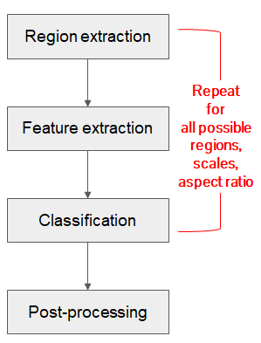
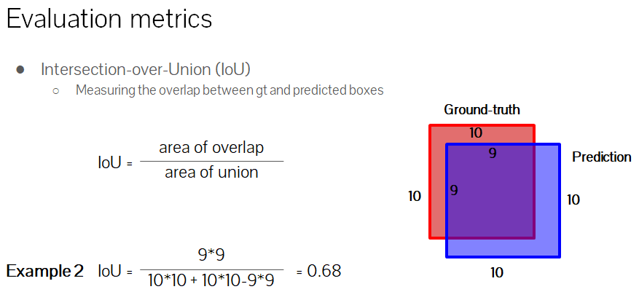
● Computer Vision 종류 : Classification, object detection,
Semantic Segmentation, Pose estimation, Activity recognition
● Object Detection : Region-based classification
classification + localization
● Pipeline of object detection : ①Region extraction → ②feature extraction
→ ③classification → post-processing
● Object Detection Challenge
1. 동일한 Object에 대하여 여러 형태
(Robust representation)
2. Processing speed를 높이는 것
● Evaluation metrics
IoU(Intersection-over-Union)
mAP(mean Average Precision)
<전통적인 Object Detection>

Slide 2
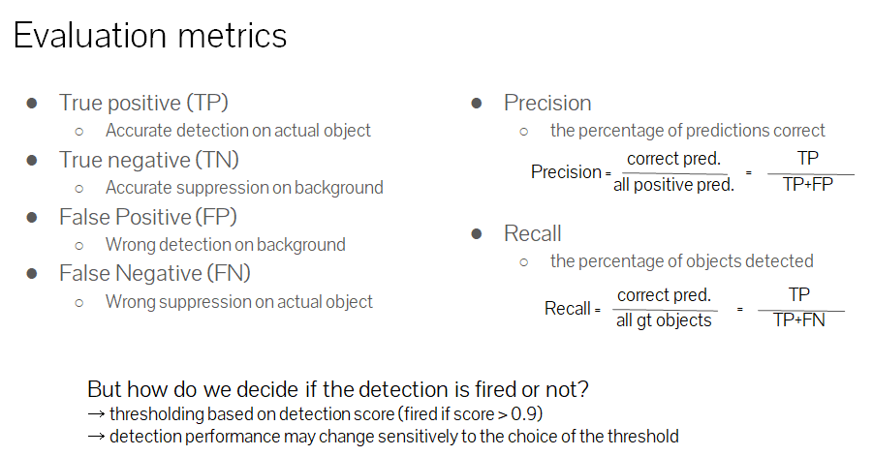
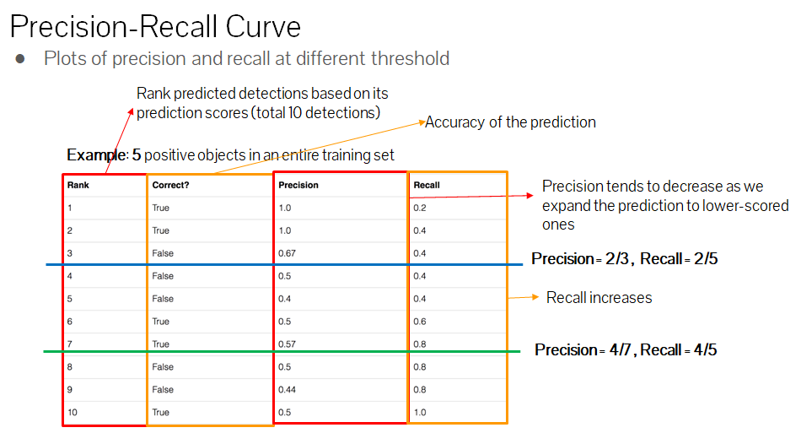

Slide 3
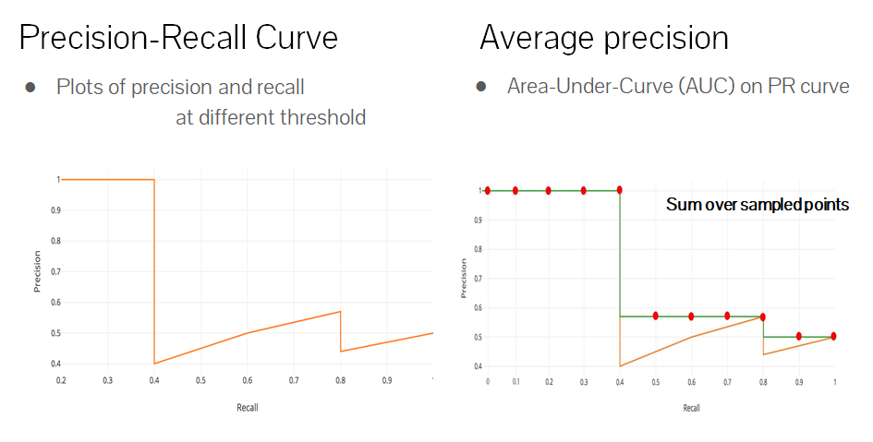
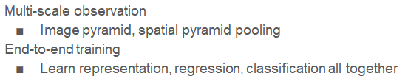

Slide 4
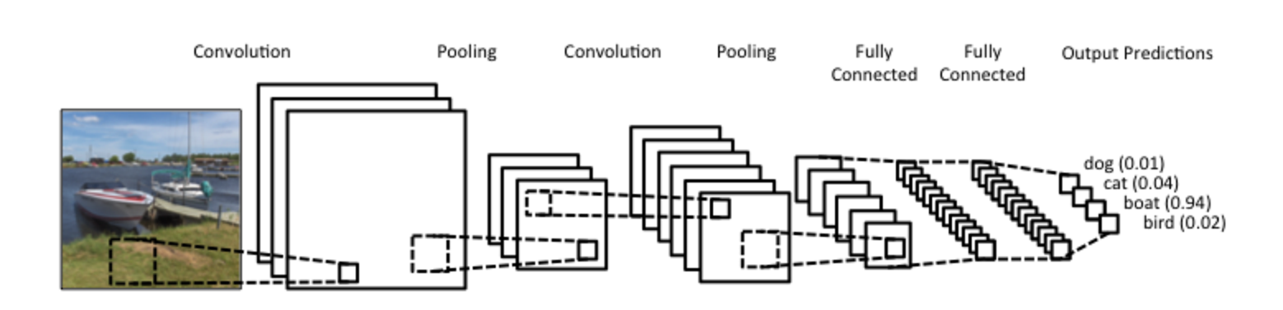
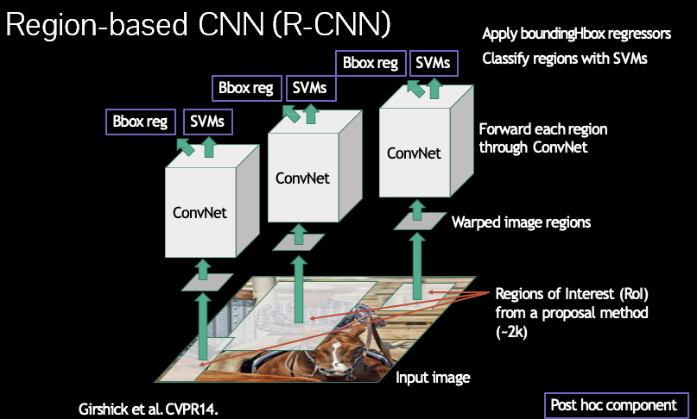
● CNN for classification
Object Detection에서 Feature extractor와 classifier를 CNN으로 구성 장점 :
large-scale 데이터셋에서 미리 학습된 network을 사용으로 강력한 표현 가능
(powerful representation, robust to various appearance variations)
● R-CNN (Region-based CNN) : feature extraction을 CNN으로 구성
Regions of Interest →CNN feature extraction→SVM classification→post-processing
장점 : powerful representation by CNN
robust to various appearance variations
단점 : 느리다 (Slow processing time)
end-to-end 최적화 불가 (최적화를 위한 CNN feature extraction와
SVM classification 동시 학습 불가)
한계 : 각 region에서의 feature extraction → 여러 ConvNet 필요 → 느려짐

Slide 5
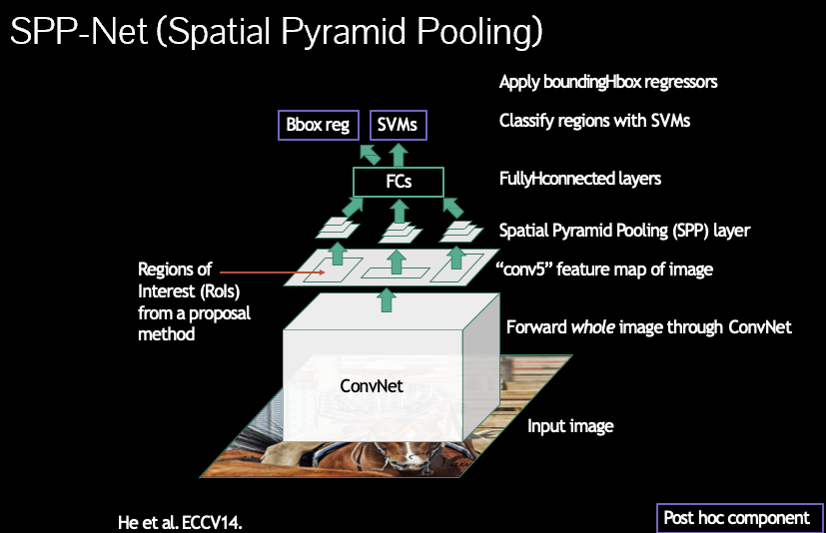
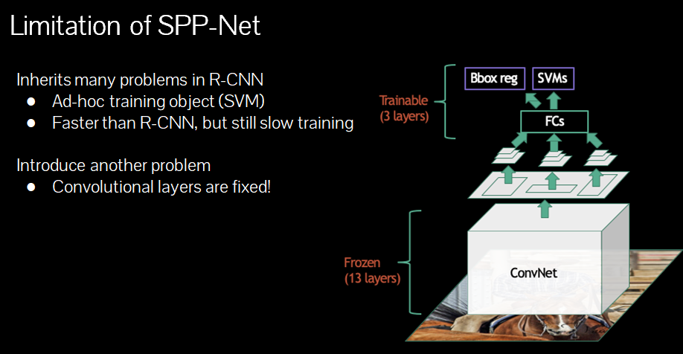
● SPP-Net(Spatial Pyramid Pooling) : 한 개의 ConvNet 사용
input image(Region Extraction) → CNN(1 ConvNet → conv feature maps & Regions of Interest(RoIs) → spatial pyramid pooling layer → concatenate → fc layer) → SVM
spatial pyramid pooling : Pooling window을 다르게 해서 여러 Resolution으로 봄 (multi-resolution)
장점 : R-CNN 보다 빠름 (그러나 느림), feature extraction을 share하여 computation 감소
단점 : R-CNN의 단점 계승 및 Convolutional Layers가 fixed

Slide 6
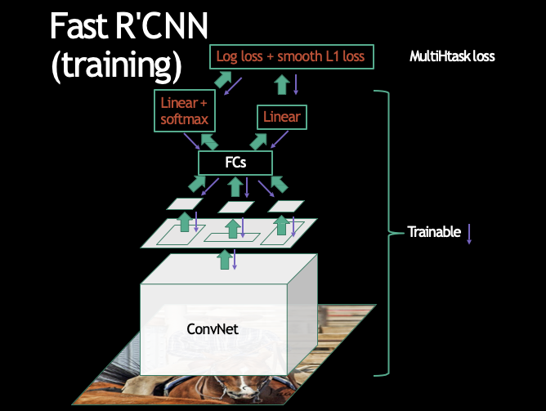
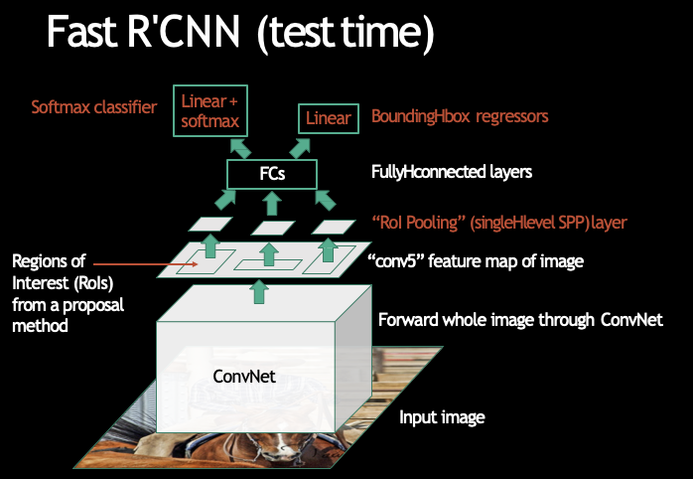
● Fast R-CNN : SPP Net에서 SVM대신 Softmax classifier와 Bounding-box regression 수행
input image(Region Extraction) → CNN(1 ConvNet → conv feature maps & Regions of Interest(RoIs) → RoI pooling layer(Single-level SPP) → fc layer → ① Softmax classifier ② Bounding-box regression)
장점 : 빠름, 학습을 통한 end-to-end 최적화 가능
● Faster R-CNN : 기존의 한계인 Region Extraction을 RPN(Region Proposal Network)을 통하여 성능 개선
input image → CNN(1 ConvNet → conv feature maps → Region Proposal Network → RoI pooling layer(Single-level SPP) → fc layer → ① Softmax classifier ② Bounding-box regression)
장점 : 매우 빠름

Slide 7
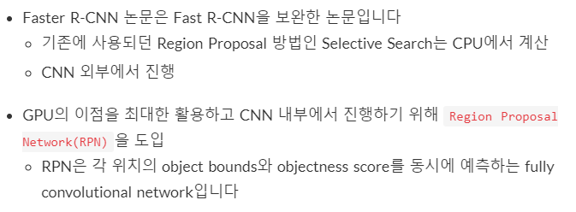
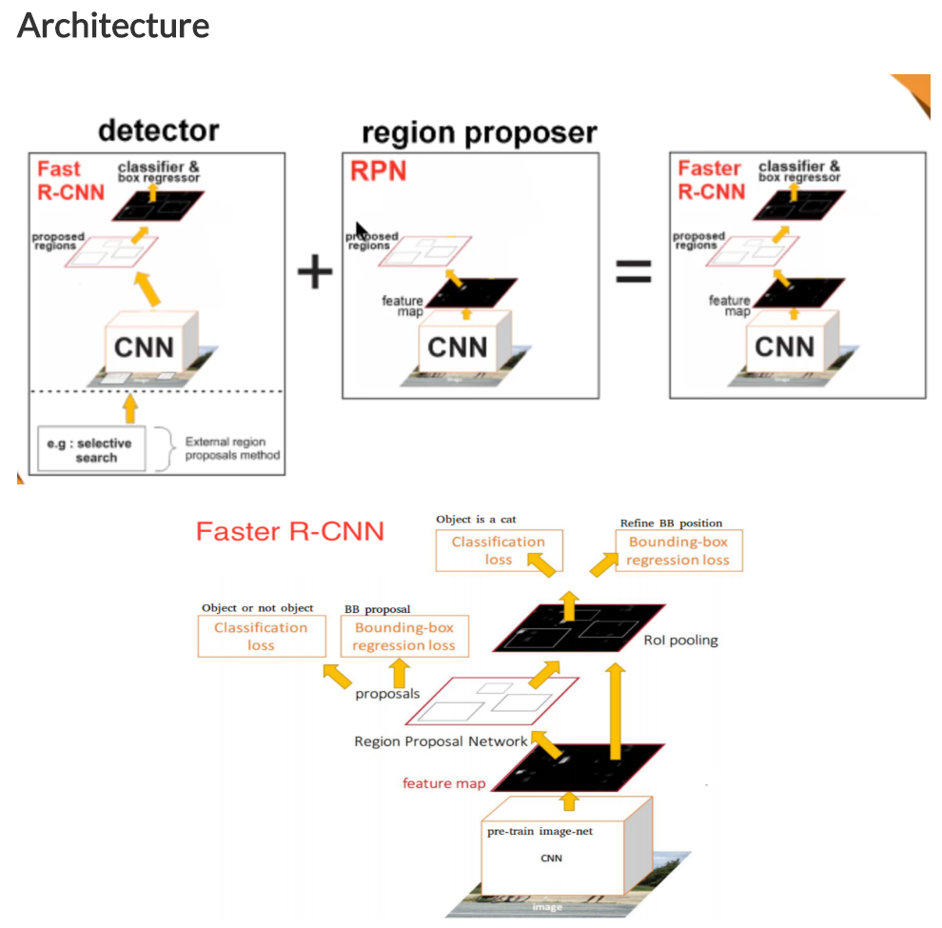
● Faster R-CNN

Slide 8
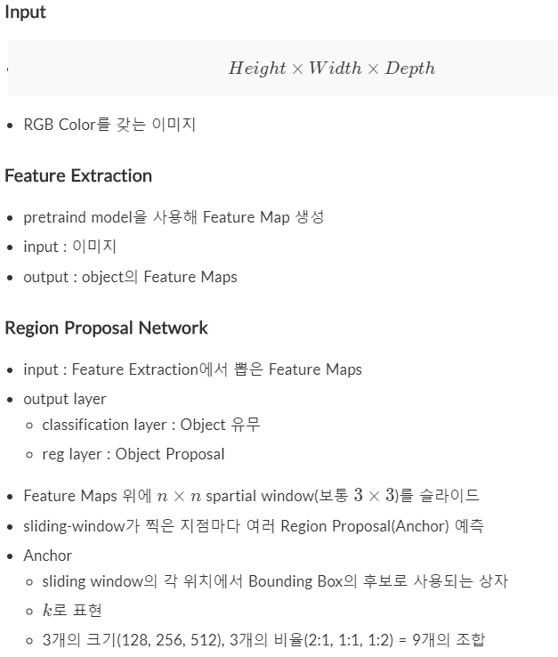
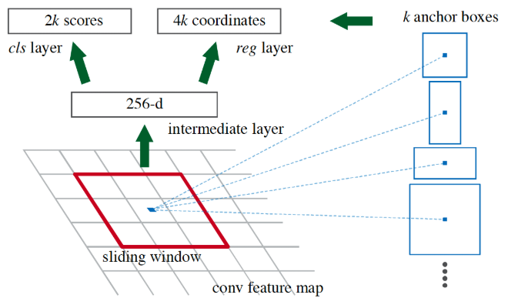

Slide 9
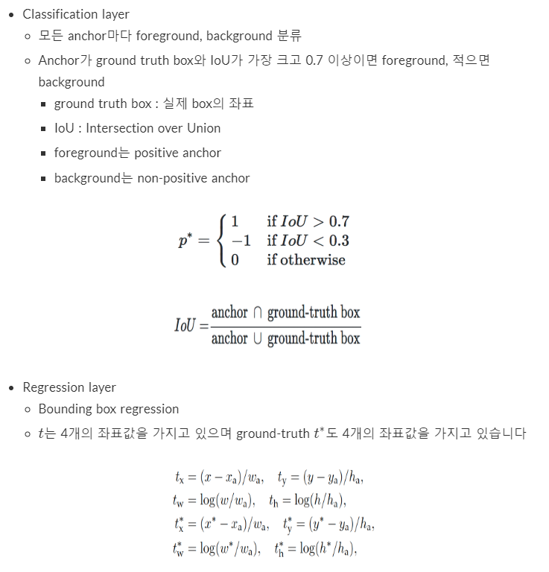
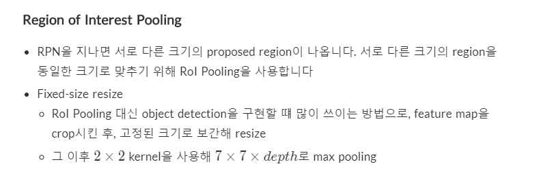

Slide 10
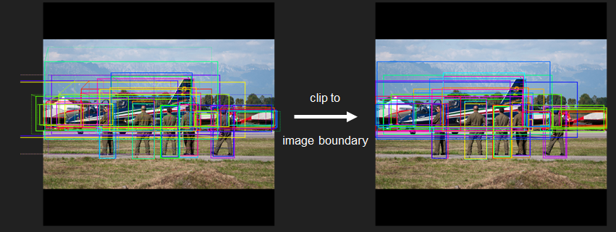
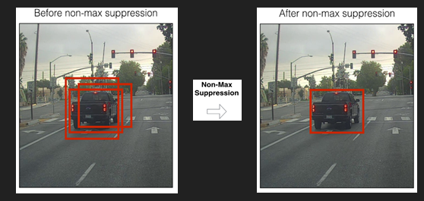
● Reducing Proposal
Anchor box가 많이 생성되어 computation 문제 발생하여 줄임 필요
800x800 input image -> 50x50 feature map -> 2,500 anchor centers
9 anchor boxes in each feature map location
50x50x9 = 22,500 anchor boxes in total
1. Clip cross-boundary anchor boxes (이미지 외부로 나가는 box를 clip)
cross-boundary anchors account for about 70% of the initial proposals
# of anchors reduces from 22,500 to about 6,000
2. NMS(non-maximum suppression)
- score를 기준으로 proposal을 나열하여 Maximum을 제외한 것 제거
2,000 proposal

Slide 11

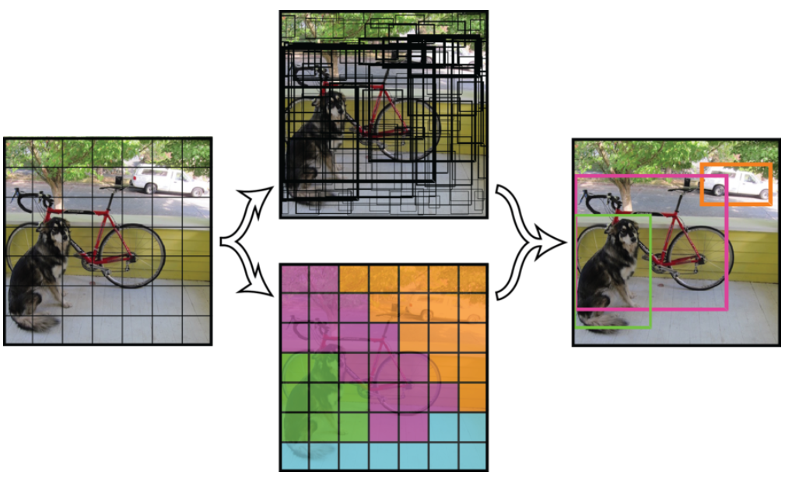
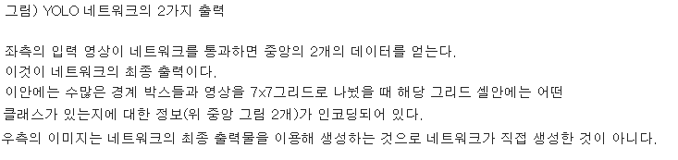
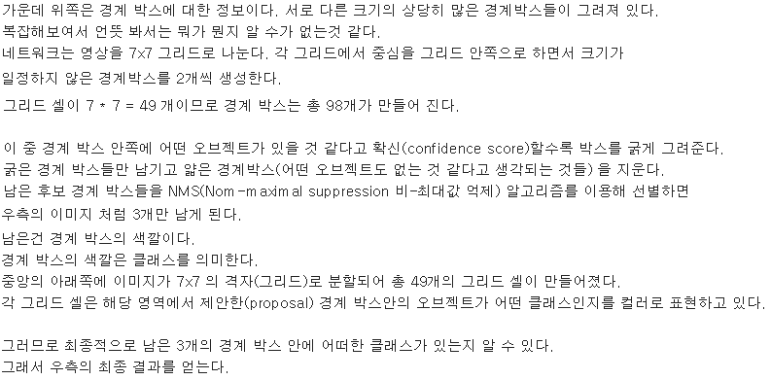
● YOLO (You Only Look Once)

Slide 12
